Slide 1
Chongqing University of Technology
ATAI
Advanced Technique of Artificial Intelligence
Chongqing University of Technology
Spectrum-based Modality Representation Fusion Graph Convolutional Network for Multimodal Recommendation
Code：https://github.com/kennethorq/SMORE
—— WSDM 2025
2024.12.26 • ChongQing
Reported by Peng Shan

Slide 2
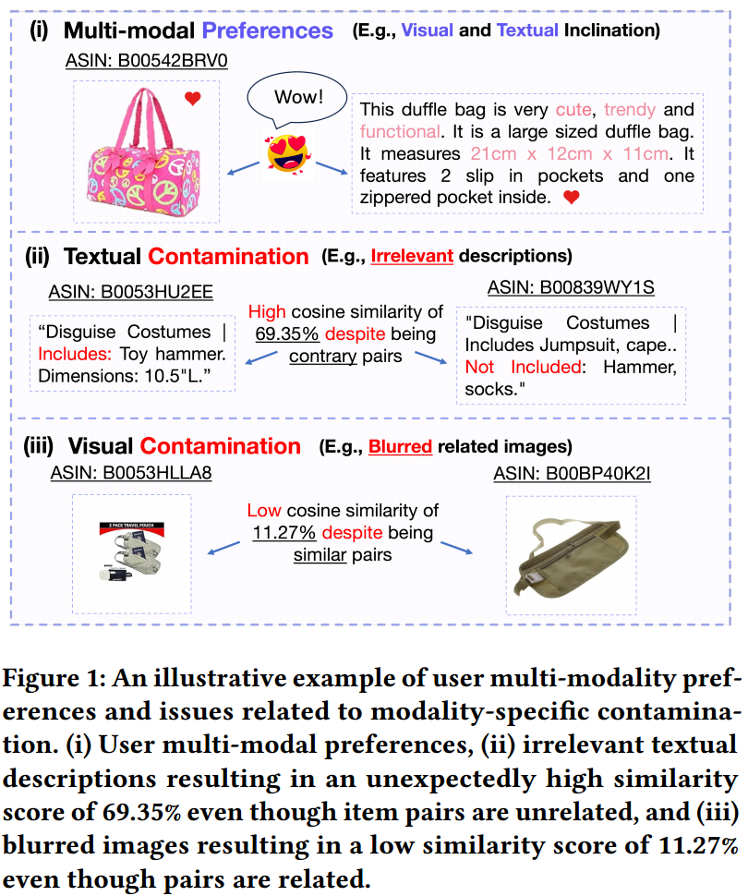
Motivation
Although it is essential to infer fusion preferences, existing works combine modalities directly without taking into account the impact of modality-specific noise, which may detrimentally affect the quality of item representations learned.

Slide 3
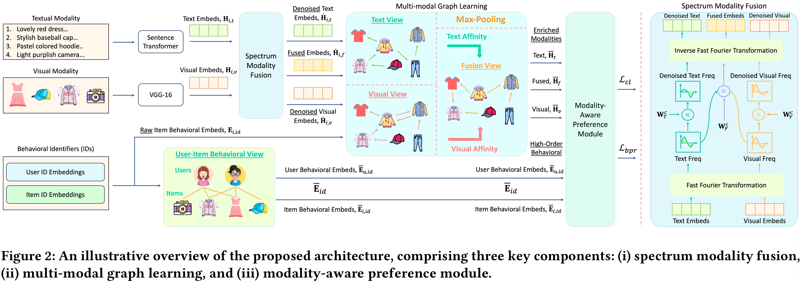
Method

Slide 4
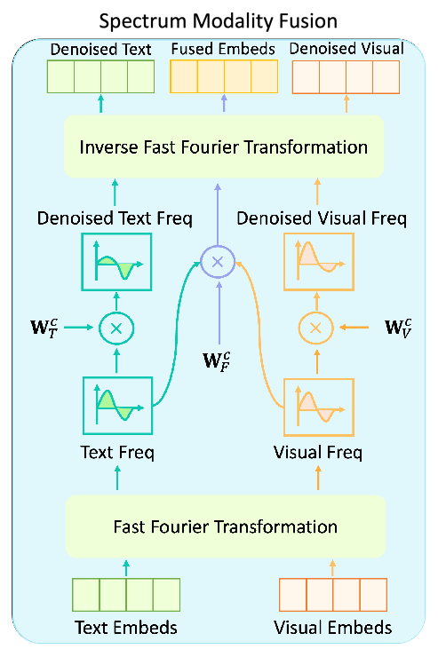
Method

Slide 5
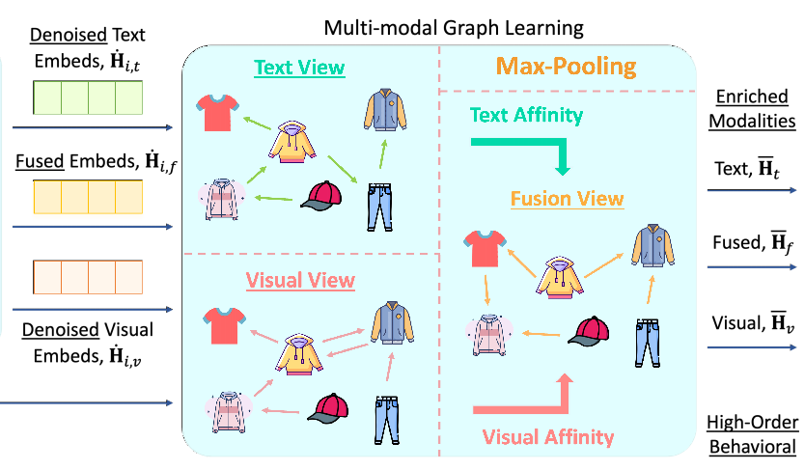
Method
f

Slide 6
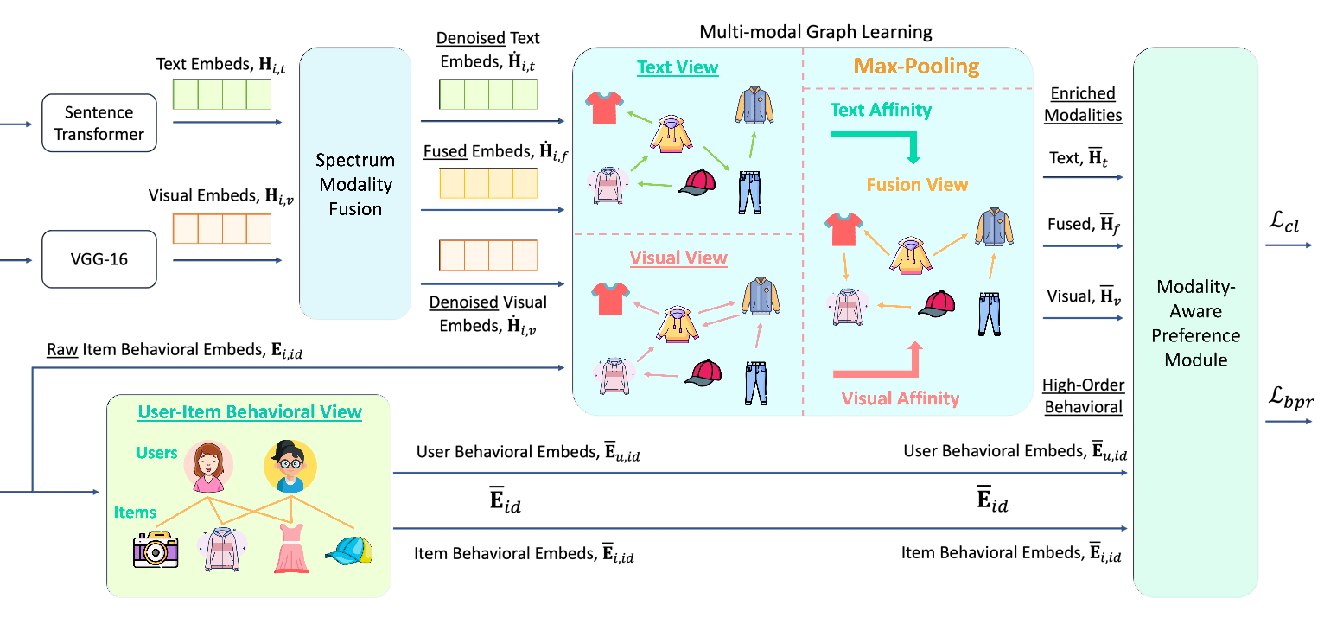
Method

Slide 7
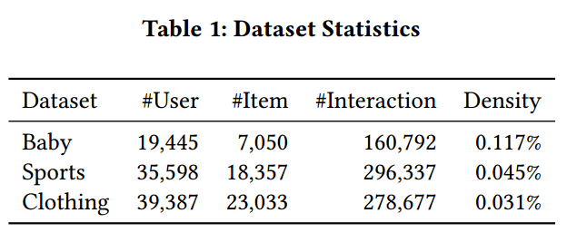
Experiments

Slide 8
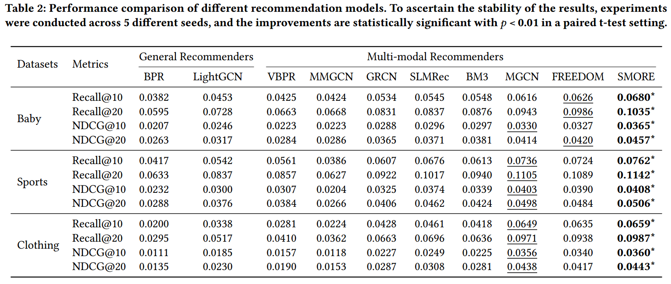
Experiments

Slide 9
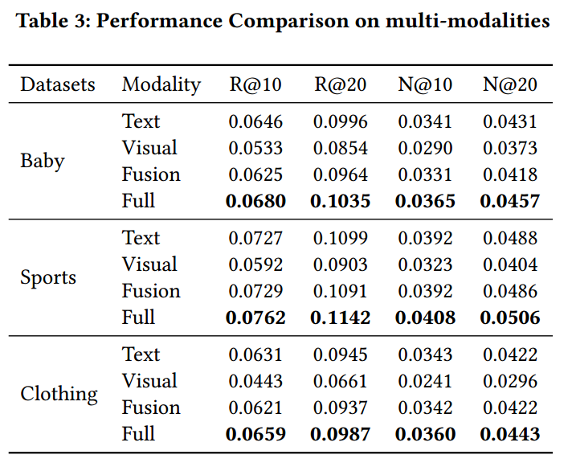
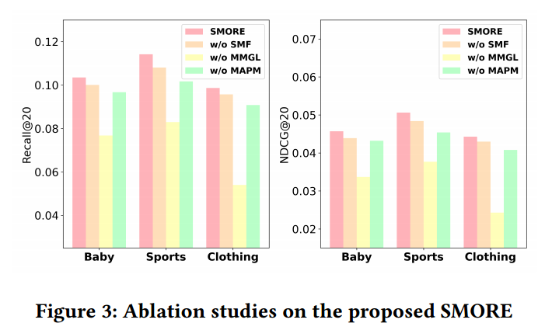
Experiments

Slide 10
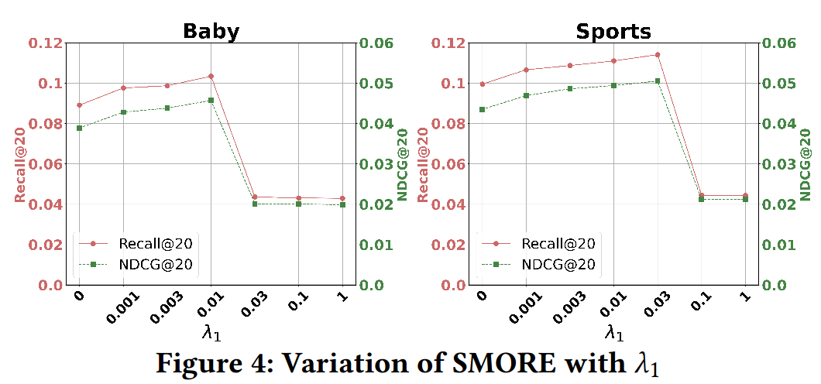
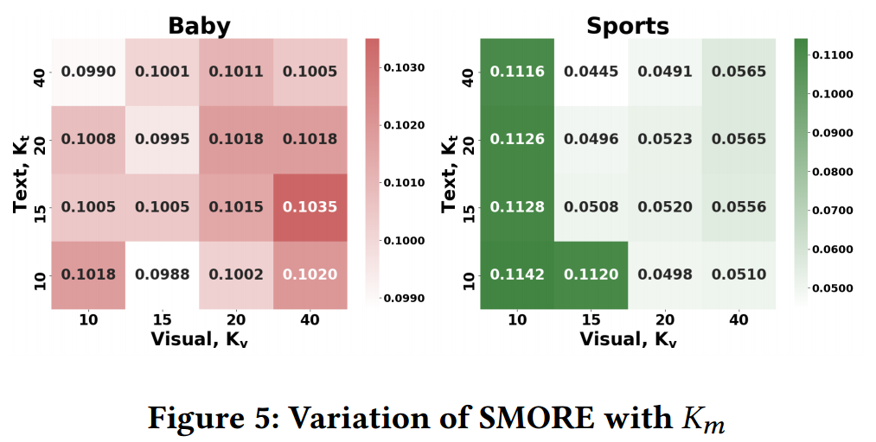
Experiments

Slide 11
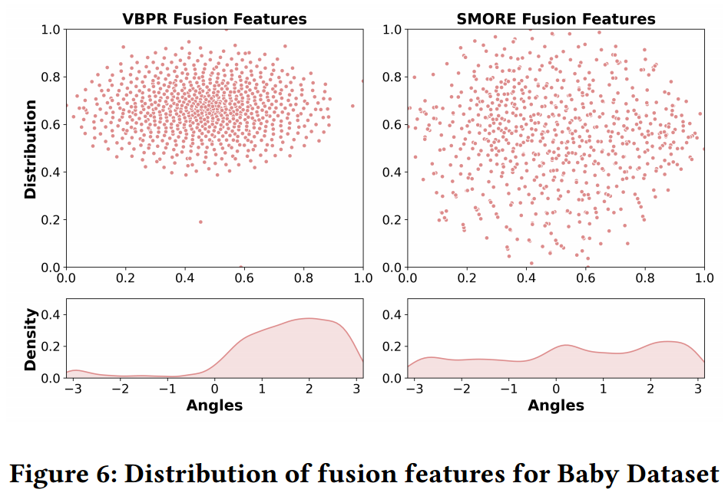
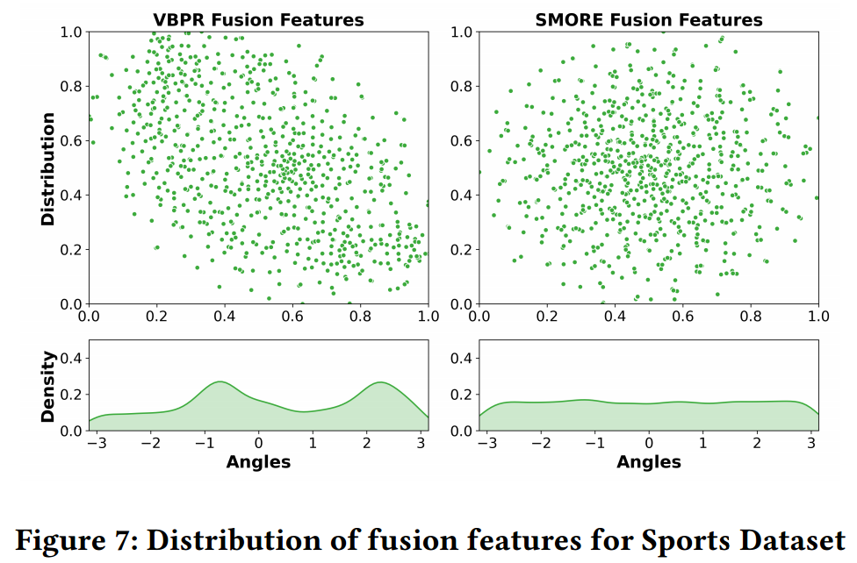
Experiments

Slide 12
Thanks!

